Slide 1

EE4203 - Design Project
Progress Review 1
Intelligent Beach Cleaning Robot
Group –14:
190378X – Mahiliny J.
190091K – Barathraj M.
190722A – Yathunanthanasarma B.
Supervised by:
Prof. Buddhika Jayasekara

Slide 2

01
Background and Motivation
02
Literature Review
03
Outline
Literature Summary
04
Objectives
05
Methodology
06
System Overview
07
Physical Overview
08
Progress – Design
09
Progress – Testing of Tracker
10
Progress – Object Detection
11
Timeframe
12
References
13
Annexes

Slide 3
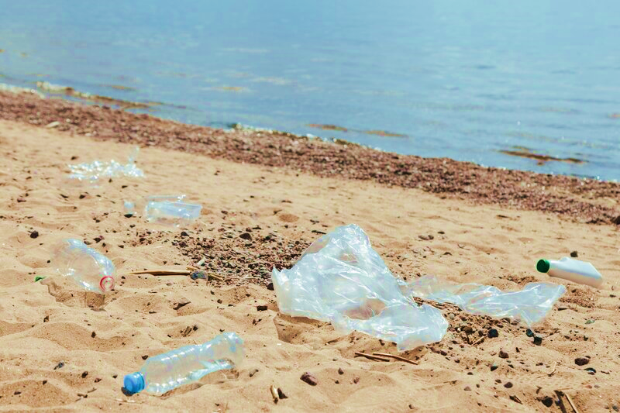
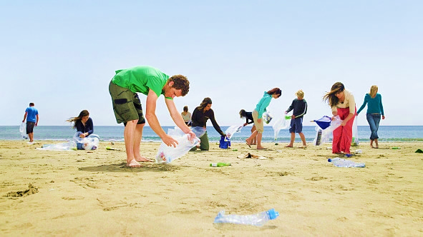
Background and Motivation
Aggregation of plastics and debris harming marine ecosystems.
Time-consuming manual cleaning efforts.
Health problems in workers (musculoskeletal diseases)
Need for an automated sustainable solution.

Slide 4
Literature Review
Refuse Collection
Refuse Collection using Lifting Conveyor Tray with a Fan [1]
Conveyor with rows of steel tines to collect garbage [2]
Refuse collection mechanisms that mimics Broom and Dustpan [4]
Autonomously collect cans using an excavator-like claw [5]
[1] G, Venugopal. (2020). Development of An Autonomous Beach Cleaning Robot. 49. 11-15.
[2] D. Varghese and A. Mohan, "Binman: An Autonomous Beach Cleaning Robot," 2022 IEEE 2nd Mysore Sub Section International Conference (MysuruCon), Mysuru, India, 2022, pp. 1-5, doi: 10.1109/MysuruCon55714.2022.9972499.
[4] T. Ichimura and S. -i. Nakajima, "Development of an autonomous beach cleaning robot “Hirottaro”," 2016 IEEE International Conference on Mechatronics and Automation, Harbin, China, 2016, pp. 868-872, doi: 10.1109/ICMA.2016.7558676.
[5] Roza, Felippe & Silva, Vinicius & Pereira, Patrick & Bertol, Douglas. (2016). Modular robot used as a beach cleaner. Ingeniare. Revista chilena de ingeniería. 24. 643-653. 10.4067/S0718-33052016000400009.
​

Slide 5
Literature Review
Object Detection
Ultrasonic Sensor Initialization, Android camera for capturing images, and ANN algorithm to classify bottles [3]
Computer vision system to detect using RGB and HSV filtering, and Obstacle avoidance with optical flow [5]
Single Shot Multibox Detector based Multi Scale Object Detection Network (SSD-MSN) [6]
[3] H. Sukri, A. Dafid and A. Basuki, "Design of Garbage Collection Robots In Tourism Area (Beach) With Artificial Neural Network Method," 2022 IEEE 8th Information Technology International Seminar (ITIS), Surabaya, Indonesia, 2022, pp. 235- 240, doi: 10.1109/ITIS57155.2022.10010038.
[5] Roza, Felippe & Silva, Vinicius & Pereira, Patrick & Bertol, Douglas. (2016). Modular robot used as a beach cleaner. Ingeniare. Revista chilena de ingeniería. 24. 643-653. 10.4067/S0718-33052016000400009.
[6] J. K.A, J. S. C, L. R. M, S. K. P.S, A. Francis and A. Babu, "Deep Learning based Beach Cleaning Robot," 2023 2nd International Conference on Applied Artificial Intelligence and Computing (ICAAIC), Salem, India, 2023, pp. 427-433, doi: 10.1109/ICAAIC56838.2023.10141099.
​

Slide 6
Literature Review
Navigation
Obstacle avoidance using Ultrasonic sensor [1]
GPS waypoint navigation using laser scanner, GPS, and IMU [2]
Autonomous navigation system using Scanning Range Finder [4]
Driving mechanism remotely controls the motion of the robot via Bluetooth module that will send and receive signals with the help of a transceiver [7]
[1] G, Venugopal. (2020). Development of An Autonomous Beach Cleaning Robot. 49. 11-15.
[2] D. Varghese and A. Mohan, "Binman: An Autonomous Beach Cleaning Robot," 2022 IEEE 2nd Mysore Sub Section International Conference (MysuruCon), Mysuru, India, 2022, pp. 1-5, doi: 10.1109/MysuruCon55714.2022.9972499.
[4] T. Ichimura and S. -i. Nakajima, "Development of an autonomous beach cleaning robot “Hirottaro”," 2016 IEEE International Conference on Mechatronics and Automation, Harbin, China, 2016, pp. 868-872, doi: 10.1109/ICMA.2016.7558676.
[7] N. Bano et al., "Radio Controlled Beach Cleaning Bot," 2019 IEEE 6th International Conference on Engineering Technologies and Applied Sciences (ICETAS), Kuala Lumpur, Malaysia, 2019, pp. 1-6, doi: 10.1109/ICETAS48360.2019.9117269.​
​

Slide 7
Literature Summary
Objectives | Techniques So Far | Research Gaps
Refuse collection mechanisms | All the products have Pick up mechanisms for large size garbage cleaning | Dual modes of refuse collection - Raking for large size garbage collection - Sieving shaker mechanism for sand filtering
Autonomous Navigation (Obstacle avoidance + Path planning) | They focus on the manual or radio control navigation | Navigate autonomously with an optimal path planning and obstacle avoidance (VFH path planning algorithm, pre-defined path)
Object detection | All the projects are done using ANN | Real time object detection YOLOv5s - Fast & Highest precision

Slide 8
Objectives
01 Design refuse collection mechanisms using CAD software.
02 Develop a functional prototype of the beach cleaning robot.
03 Implement autonomous navigation and object detection for refuse collection.

Slide 9
Methodology
Design refuse collection mechanisms.
Optimal selection of hardware components.
Train YOLOv5 object detection model.
Construct the prototype robot.
Evaluate the object detection model.
Implement autonomous navigation.
Testing and validation.

Slide 10



System Overview
Mapping & Obstacle Avoidance
Sieving Shaker Mechanism
Sensor
(Laser Range Finder / Ultrasonic)
Navigation maps
Path Planning
VFH Algorithm
Pre-defined Path
Navigation
Control
Object Detection
Raking Mechanism
Camera
(RGB)
Data
Memory

Slide 11
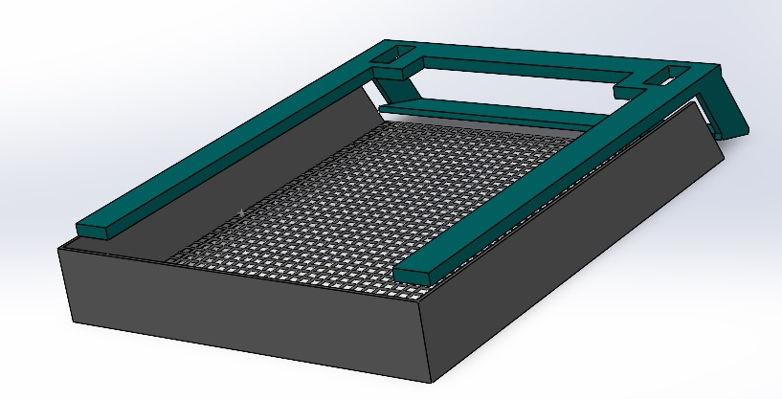
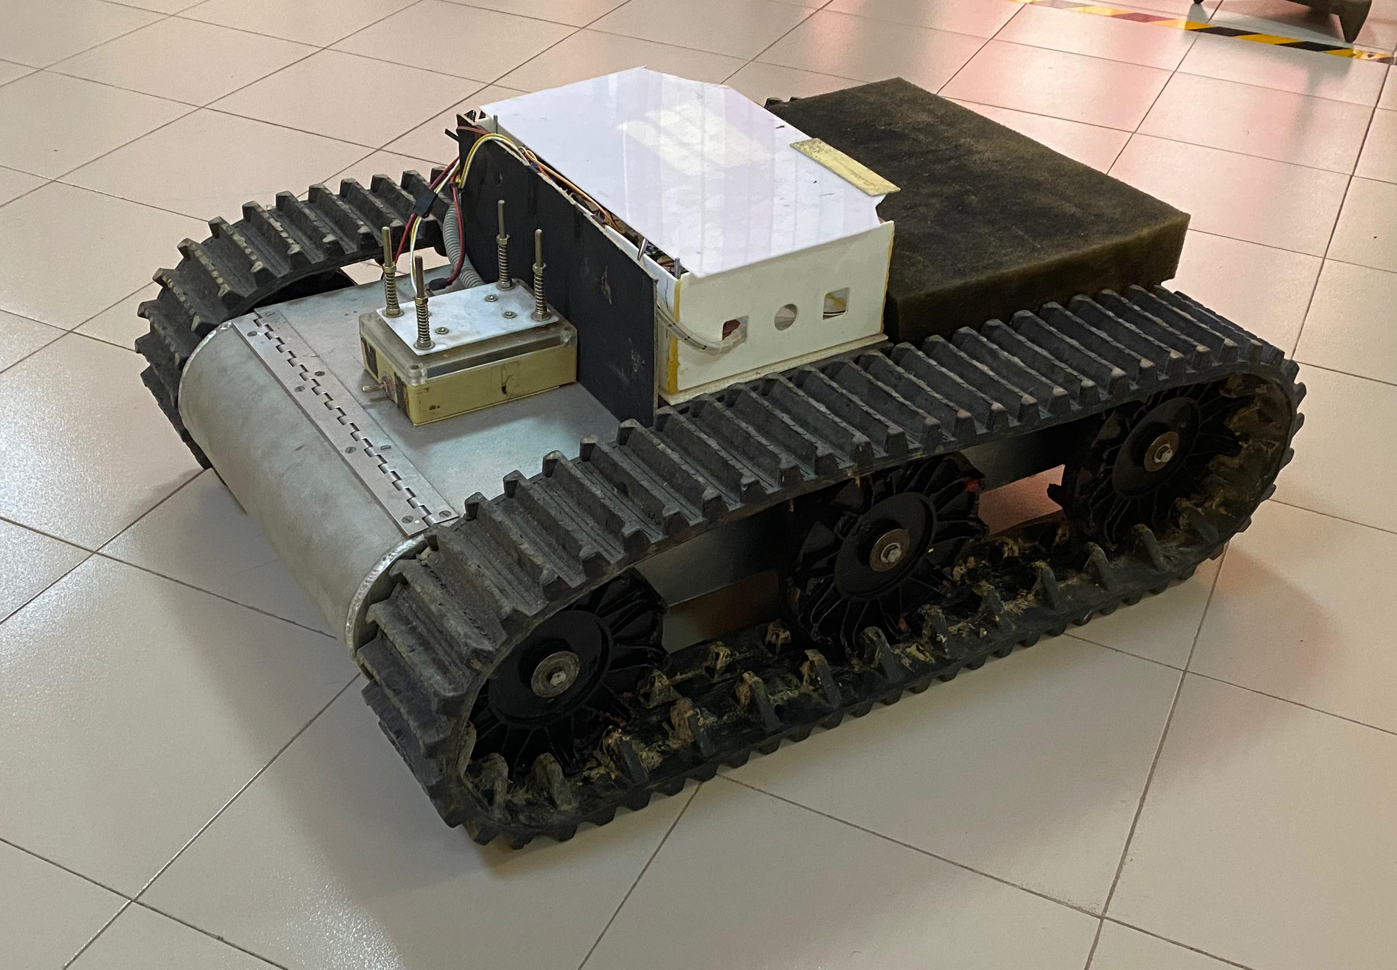
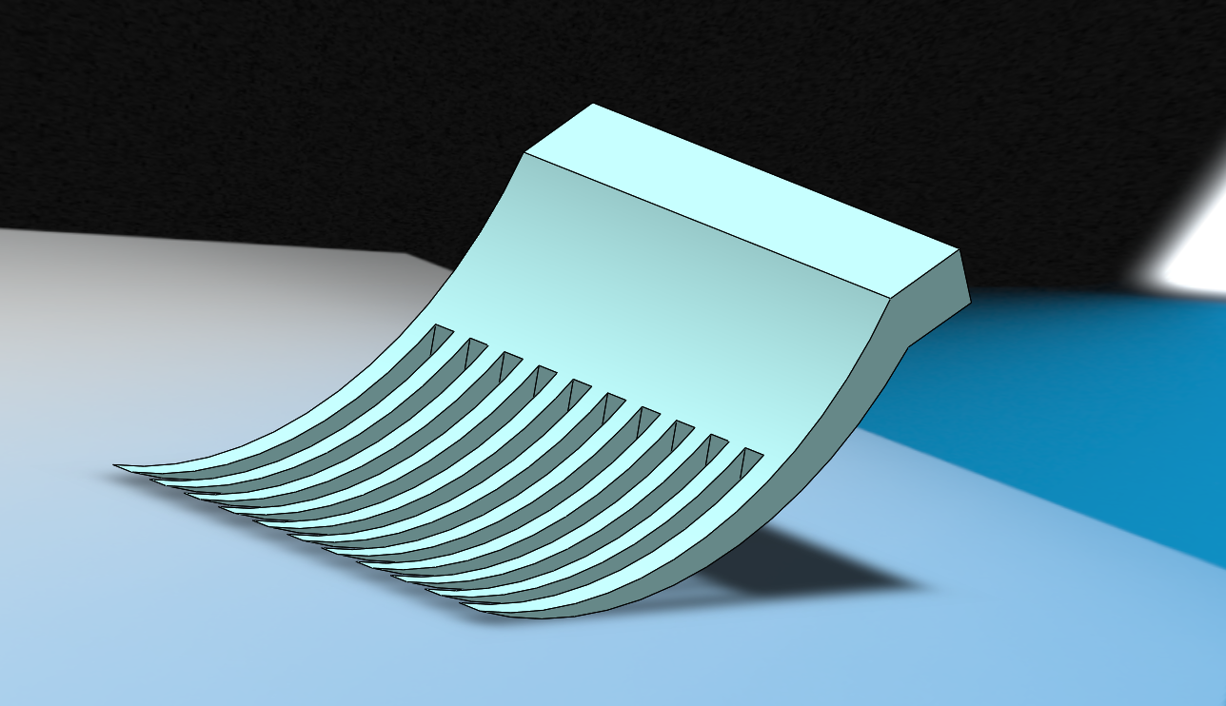
Physical Overview
Raking Mechanism
Sieving Shaker Mechanism
Tracked Mobile Robot
(Available in our laboratory)

Slide 12
Progress up to Now
Design refuse collection mechanisms
Train the YOLOv5s model
Testing the components of mobile tracker
1
2
3

Slide 13
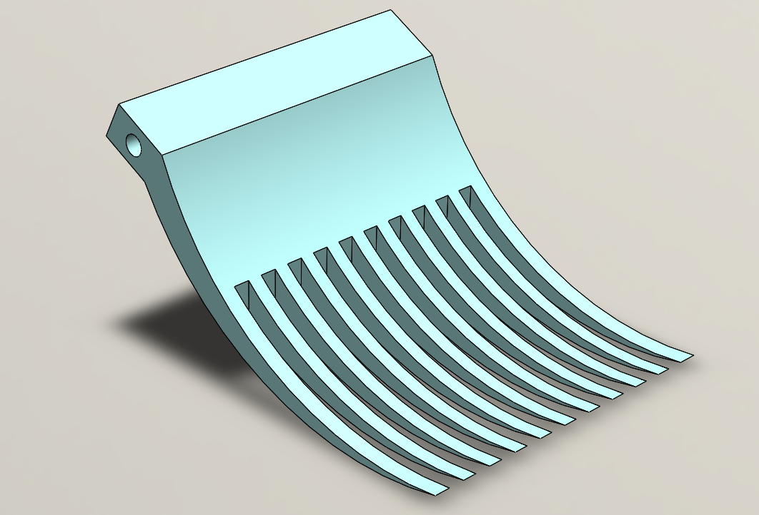
Raking Mode of Refuse Collection
A rake-like implement to scoop up surface-level debris
A revolute joint arm (1 DOF) to lift the debris into the storage bin
Refuse collection, Combining with object detection
Ensures that the robot can be quickly serviced, minimizing downtime during cleaning operations

Slide 14
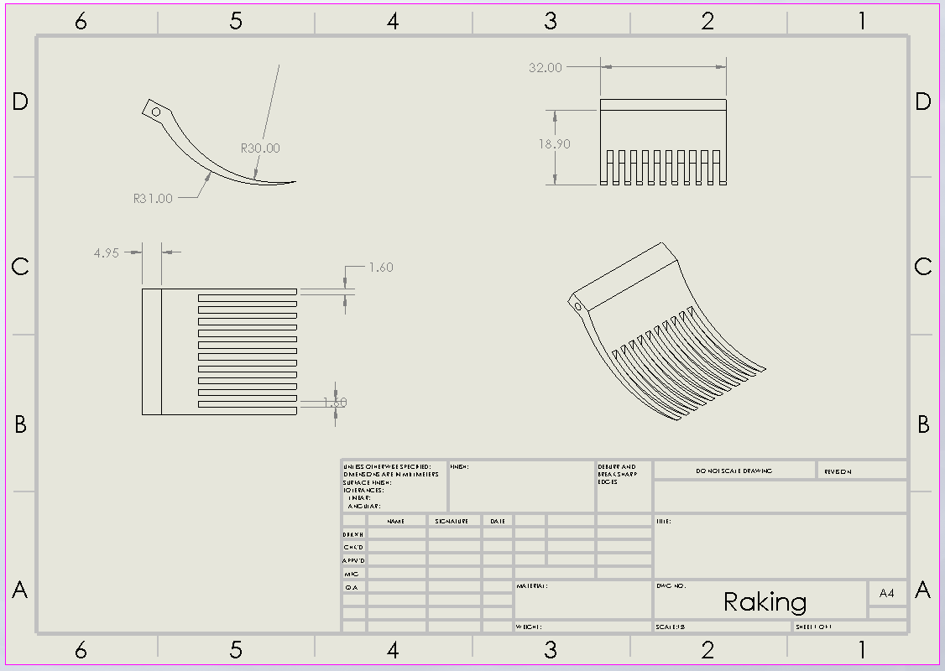
Design of Raking Mechanism
Rake parameters
= 32 cm x 25 cm
Height from landscape
= 20.4 cm
Each rake branch has,
30 : 31 Dual Curve Bending
1.6 cm space in the array

Slide 15

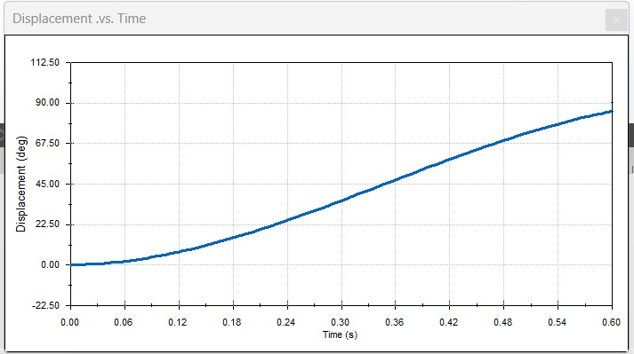
Motion Study of Raking Mechanism
When the object is detected, this raking arm starts its motion.
Pick the debris from the landscape and rotate through the revolute joint by 90 to 150 degree using servo motors.
Here, it is tested with 90 degree - one rotation with 10 rpm speed.

Slide 16
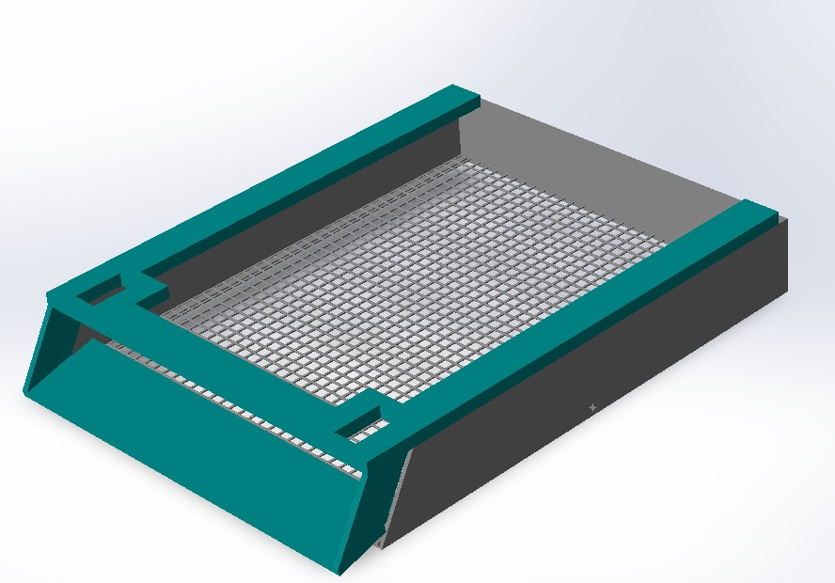
Sieving Shaker Mode of Refuse Collection
A sand director to lift the debris up to the sieve area
Vibrating mesh to sift through sand
Capture larger debris such as plastic, glass, wrappers and driftwood
Allows smaller particles like sand grains to pass through
The collected refuse - transported to a storage compartment for later disposal
Mesh Area
Sand Director

Slide 17
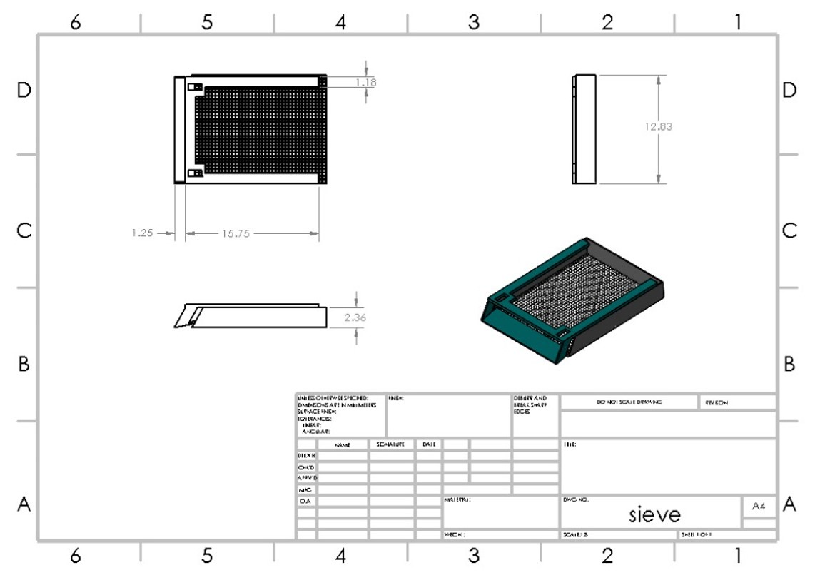
Design of Sieving Shaker Mechanism
Vibrating Mesh
Height = 6 cm
Mesh Dimension = 32 cm x 40 cm
Mesh Area = 0.128 m²
Sand Director
Dimension = 32 cm x 4 cm

Slide 18

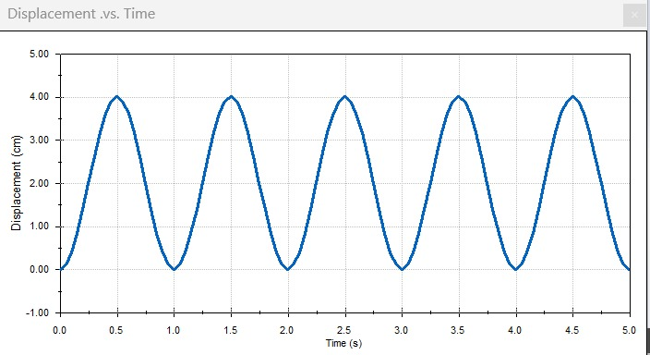
Motion Study of Sieving Mechanism
Vibration : Preset frequency of 60 rotations per minute (rpm) and Vibration Range of 4 cm.
The sand director frame is attached together with the sieve mesh frame using an interconnector with two joints – rigid one and a free one

Slide 19
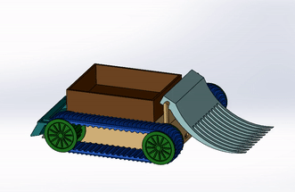
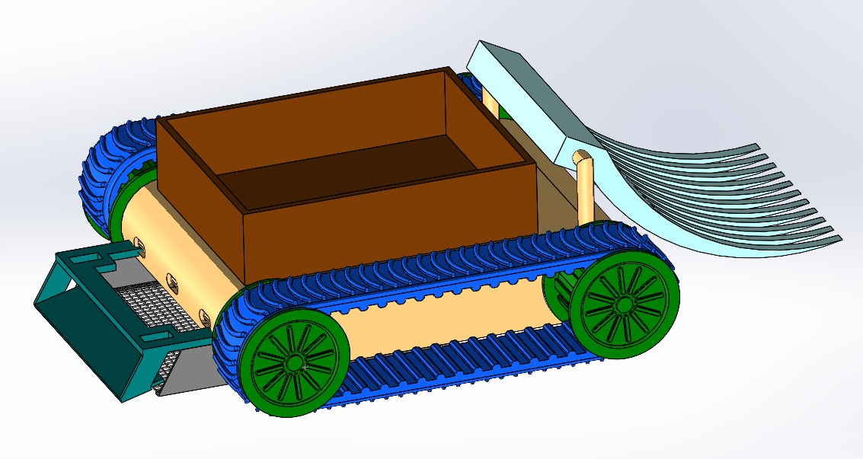
Overall Design of the Robot
Garbage Collector
Raking Mechanism
Dual Mode of Operation for Refuse Collection
Sieving Shaker Mechanism

Slide 20
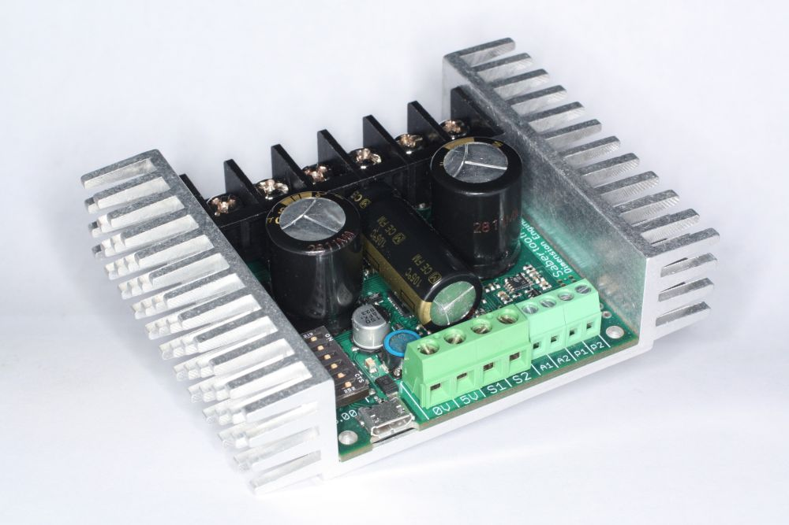
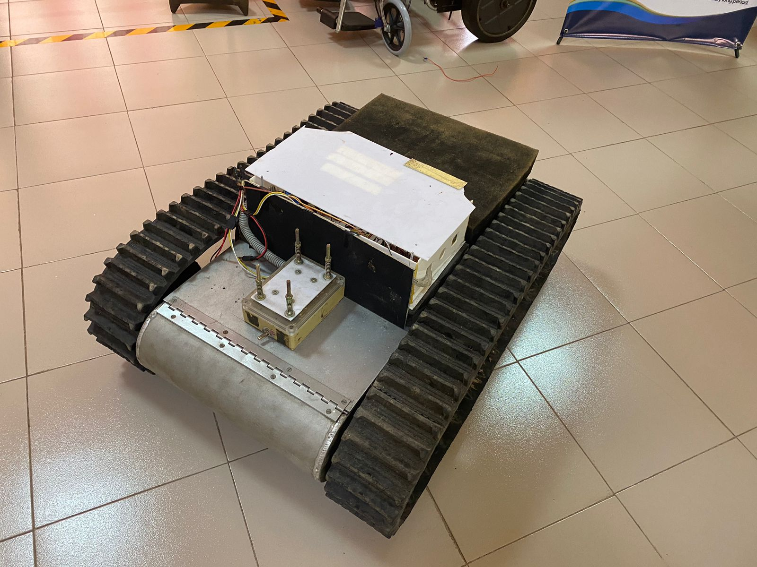
Testing of the Mobile Tracking Vehicle
Sabertooth 2x32 regenerative motor driver
Tracked Mobile Robot
Motors are in the working condition
Motor driver has some issues
Working with driver testing

Slide 21
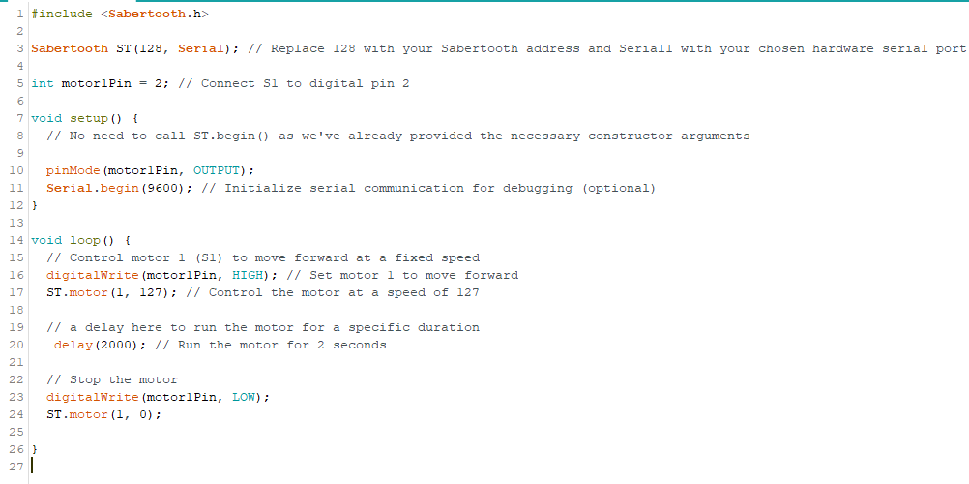
Testing of the Mobile Tracking Vehicle
PWM signal input
Run the motor - forward
Stop the motor

Slide 22
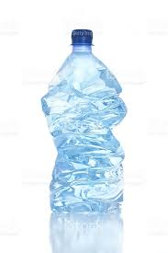
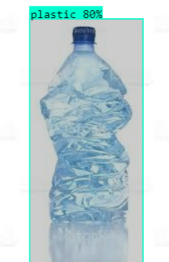
Object Detection
Obtained labeled datasets for garbage.
Trained a YOLOv5s model to detect garbage.
Trained with different datasets to check the accuracy.

Slide 23
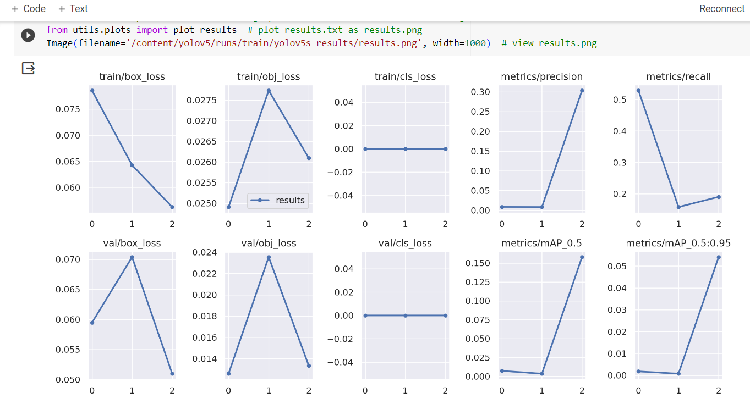
Object Detection
Increased
the number of
Training epochs
while monitoring the Model’s performance.
Precision is 30%

Slide 24
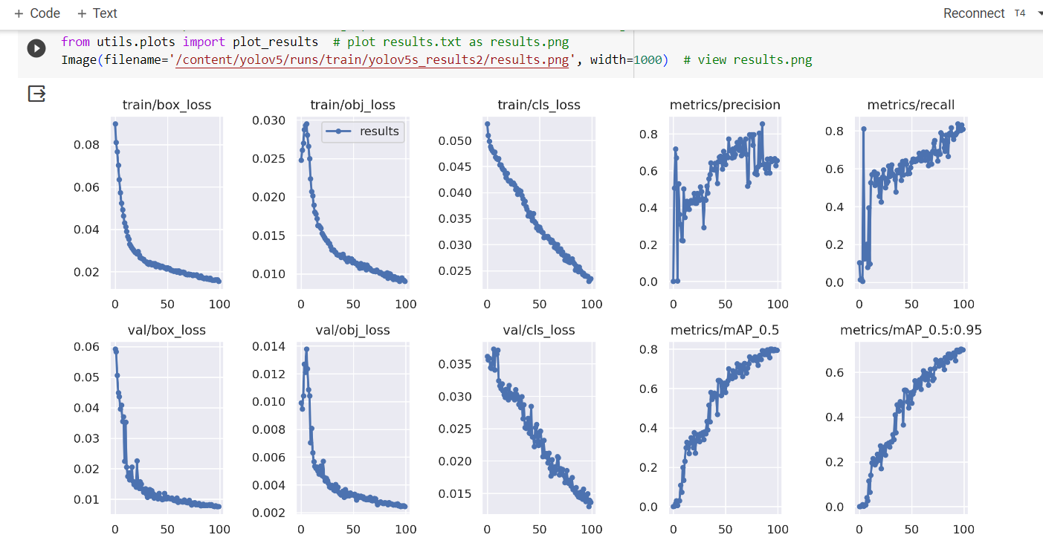
Object Detection
Precision > 86%

Slide 25
Object Detection
When adjusting the hyperparameters
Precision is increased to nearly 88%
Bounding box regression loss(Mean Squared Error) and classification loss are minimized to 0.01
Considerations to improve the precision
Can improve the dataset’s quality
Add images from different environment and lighting conditions

Slide 26

Timeframe

Slide 27
References
[1] G, Venugopal. (2020). Development of An Autonomous Beach Cleaning Robot. 49. 11-15.
[2] D. Varghese and A. Mohan, "Binman: An Autonomous Beach Cleaning Robot," 2022 IEEE 2nd Mysore Sub Section International Conference (MysuruCon), Mysuru, India, 2022, pp. 1-5, doi: 10.1109/MysuruCon55714.2022.9972499.
[3] H. Sukri, A. Dafid and A. Basuki, "Design of Garbage Collection Robots In Tourism Area (Beach) With Artificial Neural Network Method," 2022 IEEE 8th Information Technology International Seminar (ITIS), Surabaya, Indonesia, 2022, pp. 235- 240, doi: 10.1109/ITIS57155.2022.10010038.
[4] T. Ichimura and S. -i. Nakajima, "Development of an autonomous beach cleaning robot “Hirottaro”," 2016 IEEE International Conference on Mechatronics and Automation, Harbin, China, 2016, pp. 868-872, doi: 10.1109/ICMA.2016.7558676.
[5] Roza, Felippe & Silva, Vinicius & Pereira, Patrick & Bertol, Douglas. (2016). Modular robot used as a beach cleaner. Ingeniare. Revista chilena de ingeniería. 24. 643-653. 10.4067/S0718-33052016000400009.
[6] J. K.A, J. S. C, L. R. M, S. K. P.S, A. Francis and A. Babu, "Deep Learning based Beach Cleaning Robot," 2023 2nd International Conference on Applied Artificial Intelligence and Computing (ICAAIC), Salem, India, 2023, pp. 427-433, doi: 10.1109/ICAAIC56838.2023.10141099.
[7] N. Bano et al., "Radio Controlled Beach Cleaning Bot," 2019 IEEE 6th International Conference on Engineering Technologies and Applied Sciences (ICETAS), Kuala Lumpur, Malaysia, 2019, pp. 1-6, doi: 10.1109/ICETAS48360.2019.9117269.

Slide 28

Thank You !

Slide 29
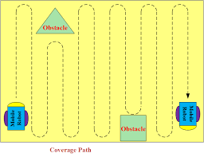
Annex
Path Planning for the Sieving shaker mechanism
Pre-defined Algorithm
Obstacle Avoidance
Sand Filtering

Slide 30
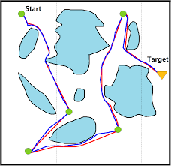
Annex
Obstacles (statics)
Path Planning for the Raking mechanism
Vector Field Histogram (VFH) Algorithm
Obstacle Avoidance
Object Detection
Objects (Plastics)

Slide 31
Annex
Object detection
YOLO loss function is composed of three parts:
box_loss — bounding box regression loss (Mean Squared Error).
obj_loss — the confidence of object presence is the objectless loss.
cls_loss — the classification loss (Cross Entropy).
Precision measures how much of the bbox predictions are correct ( True positives / (True positives + False positives)).
Recall measures how much of the true bbox were correctly predicted ( True positives / (True positives + False negatives)).
‘mAP_0.5’ is the mean Average Precision (mAP) at IoU (Intersection over Union) threshold of 0.5.
‘ mAP_0.5:0.95’ is the average mAP over different IoU thresholds, ranging from 0.5 to 0.95.

Slide 32
Annex
Proactive Behavior of System
Ability to take initiative and perform tasks without explicit human instruction
Using the sensor data (RGB camera & ultrasonic sensor) to perceive the environment, and assess the condition of the beach
Decision-Making and Planning
About which areas need cleaning
Prioritize tasks
Which mode to choose? Raking or Sieving

Slide 33
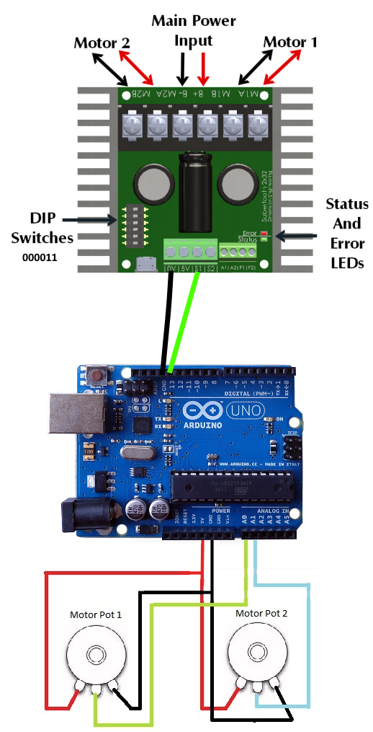
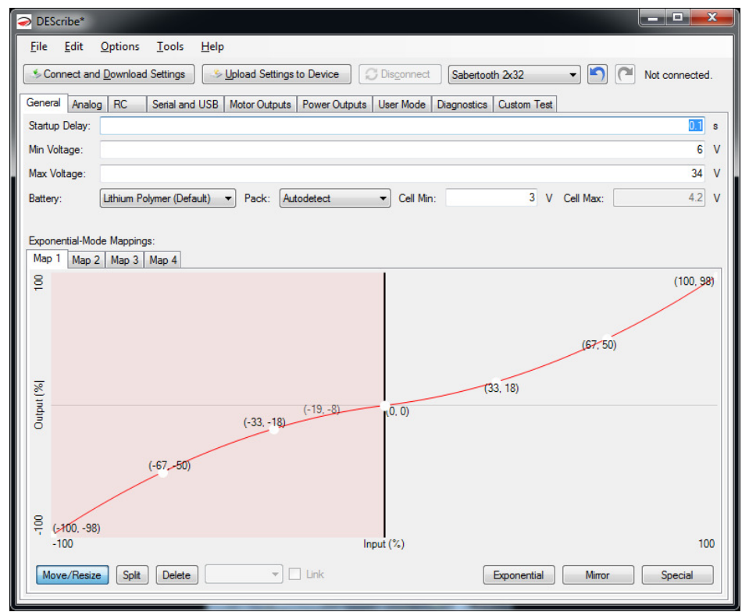
Annex
Motor Driver Connection
DEScribe PC software for Sabertooth motor driver

Slide 34
Annex
Path Planning
Sieving Shaker Mechanism
Sand Filtering
Pre-defined Path
Raking Mechanism
Object Detection
VFH Algorithm

Slide 35
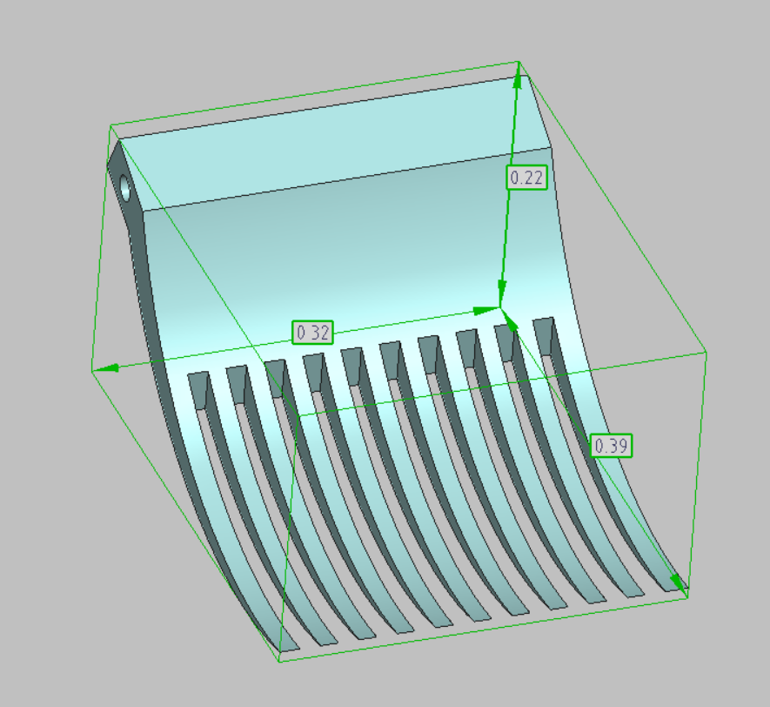
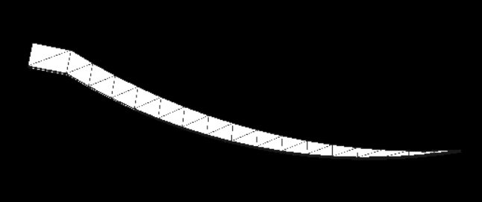
Annex

Slide 36
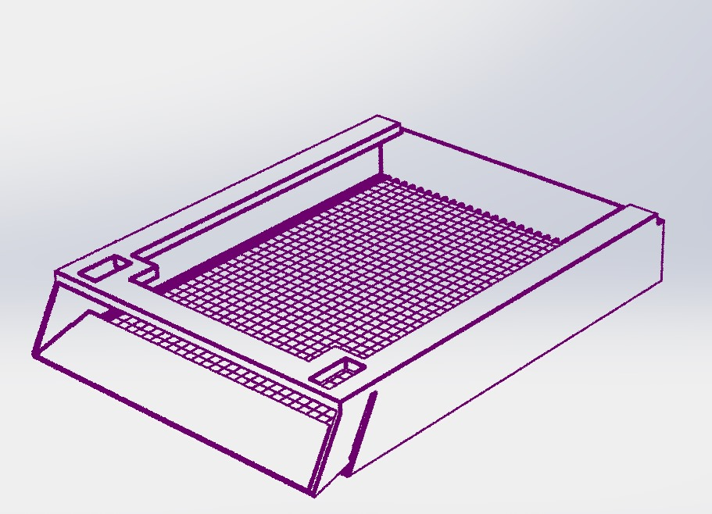
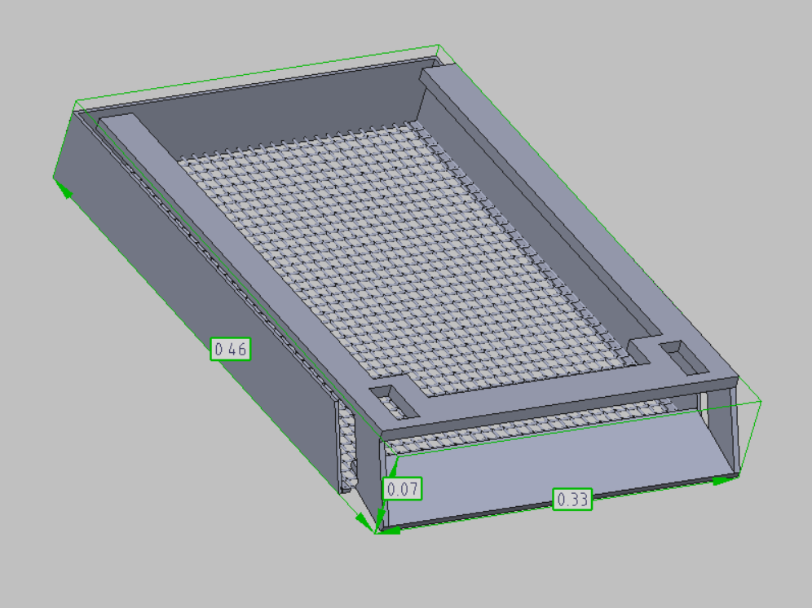
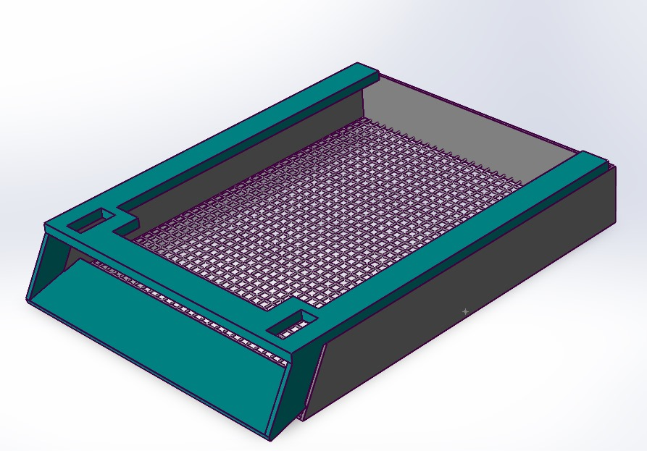
Annex

